Slide 1
North South University Department of Electrical & Computer Engineering Junior Project weekly presentation 1 Title of the Project : Create your own identity Name and IDs of the students: 1.Shawon Das 1712591642 2.Smita Roy Jyoti 1711615042 Faculty’s Name: Intisar Tahmid Naheen (Itn) Submission Date : 27-07-2020

Slide 2
Slack
All ScreenSorts till now :

Slide 3
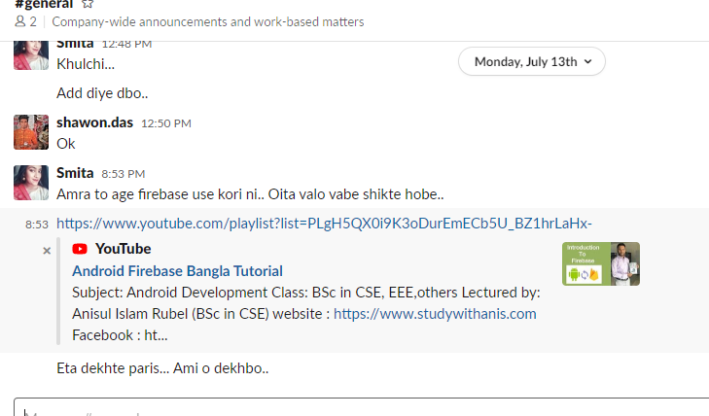
Resourses
we talked before opening the slack channel about our topic and idea. After opening slack we talked about firebase use and learning

Slide 4
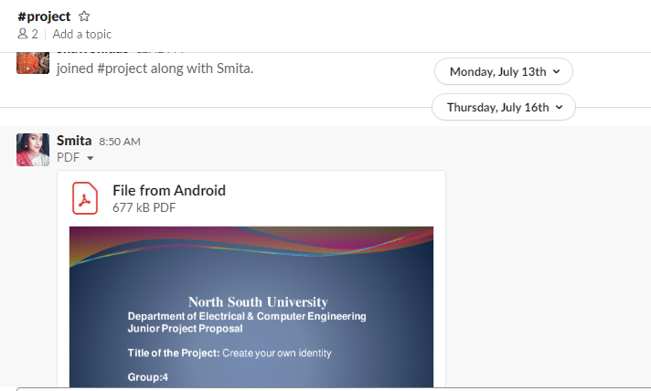

Slide 5
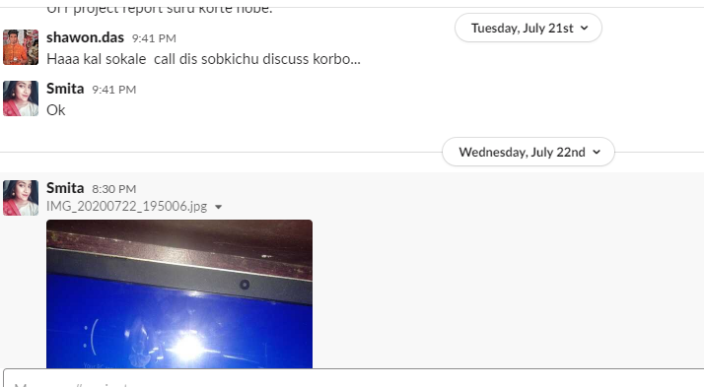

Slide 6
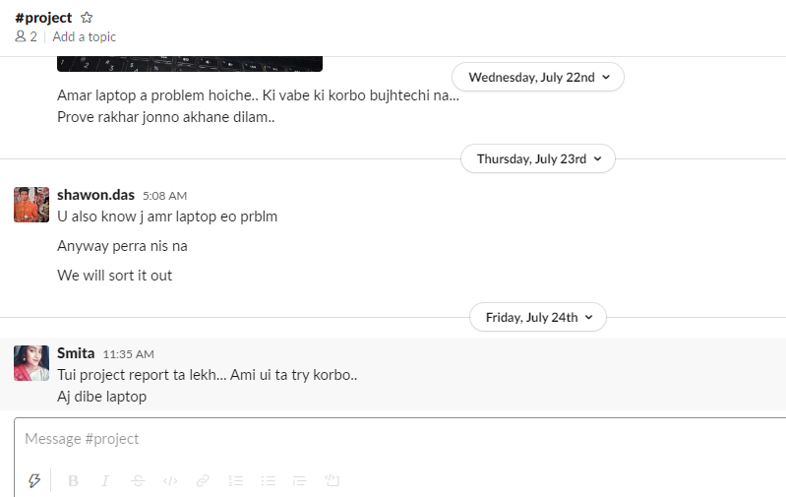

Slide 7
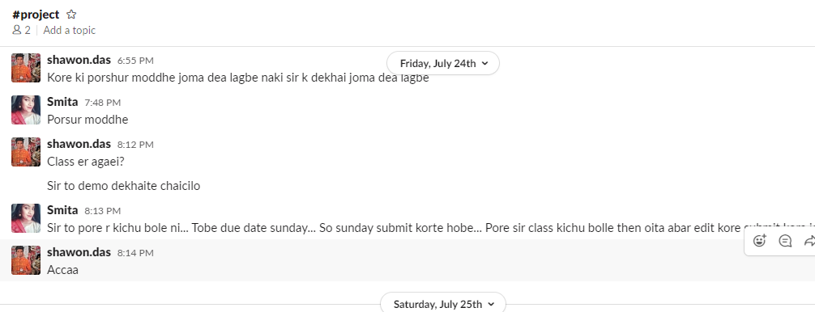

Slide 8
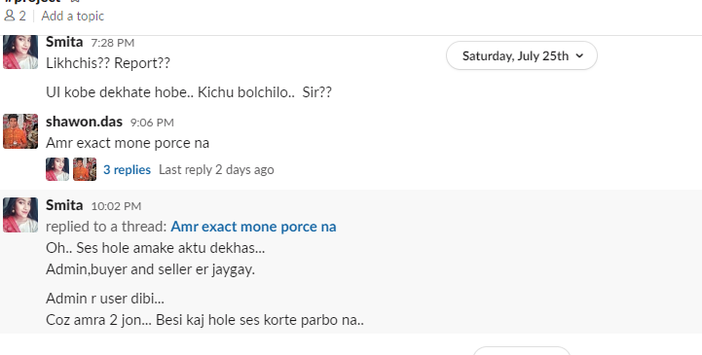

Slide 9
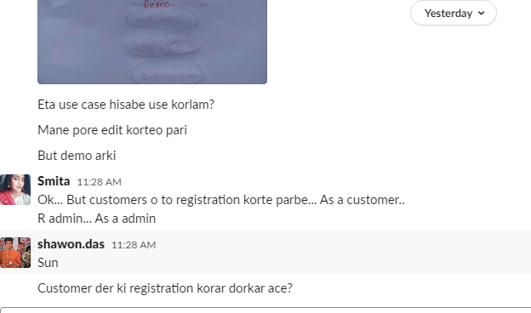

Slide 10
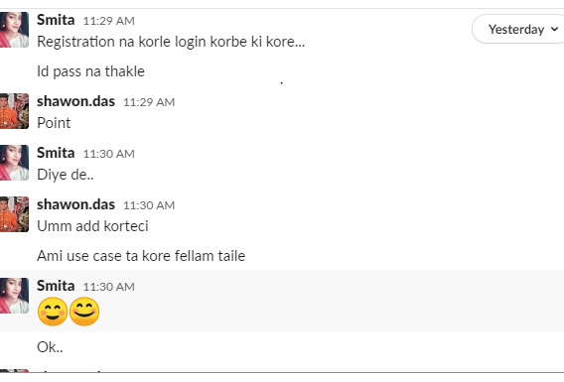

Slide 11
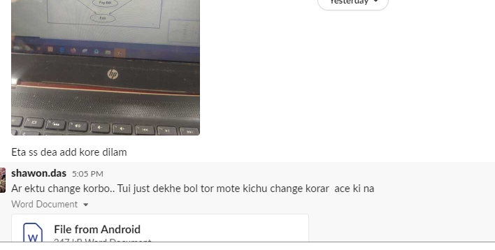

Slide 12
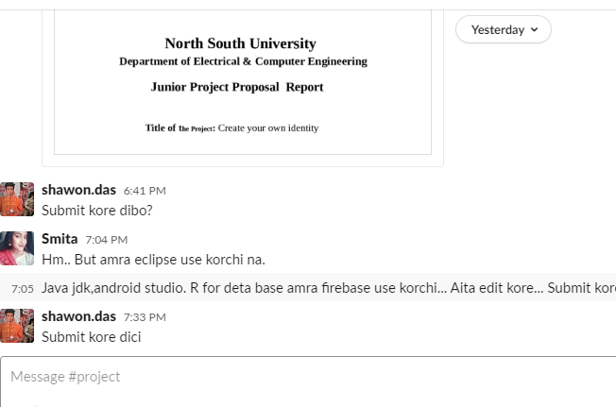

Slide 13
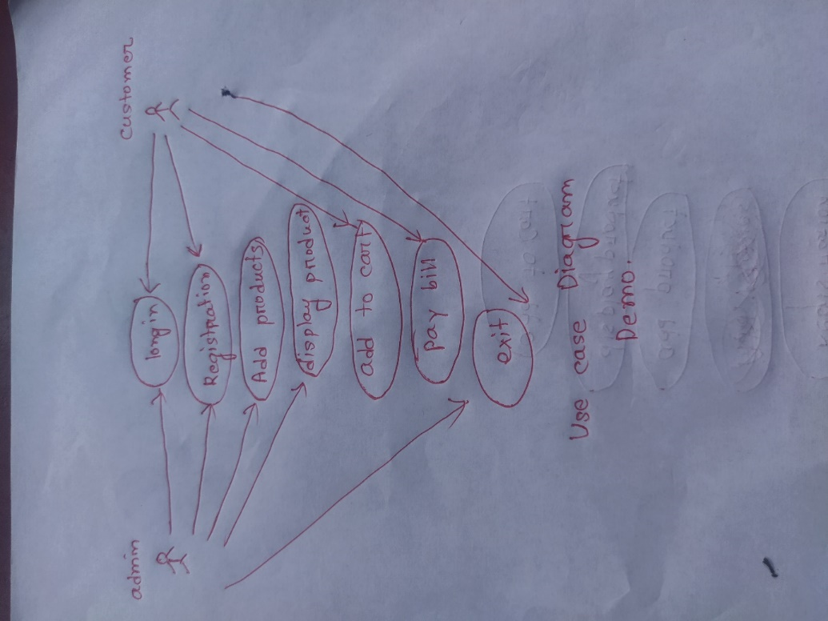
Use case Diagram demo

Slide 14
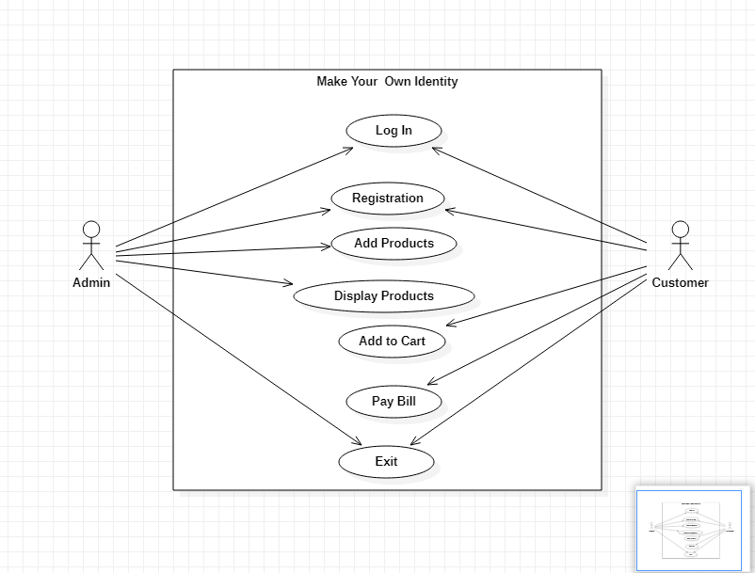

Slide 15
Trello Screensort
Some other tasks will be added. We will discuss with you about it next class.

Slide 16
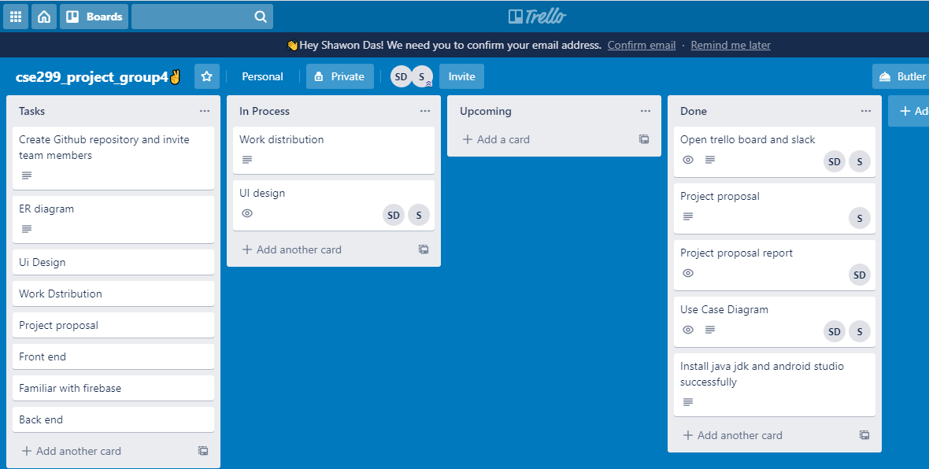

Slide 17
Coding

Slide 18
We made a small part of UI design of this week because We are not familiar with android studio . We are trying to learn quickly .

Slide 19
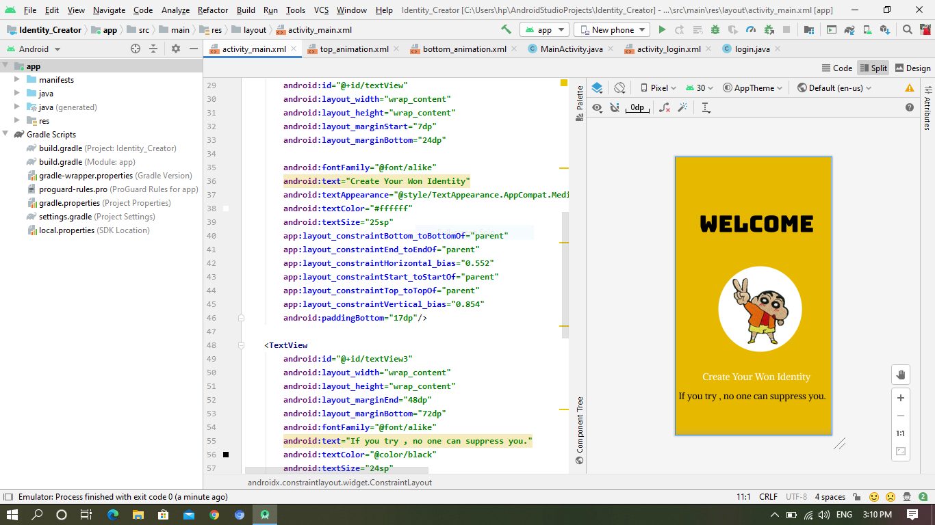

Slide 20
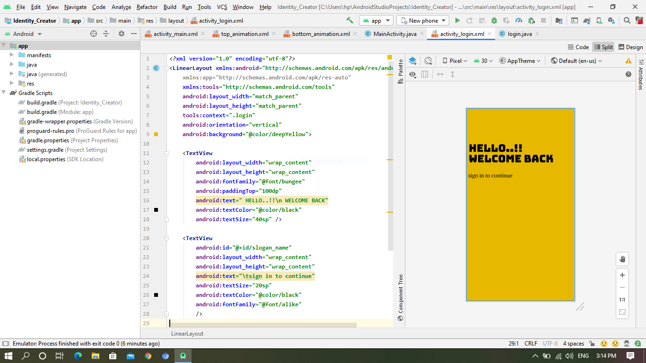

Slide 21
Thank You

